Slide 1
Image steganography embedded with Advance Encryption System
Project Supervisor-
Ms. Shivani Dubey
By-
Yash Kumar Shukla
1809114910

Slide 2
Table of Contents
1. Objective
2. Scope
3. Architecture Model
4. Structural Model
5. Behavioral Model

Slide 3
Objective
In this project we primarily focus on the data security issues when sending the data using steganographic and cryptographic techniques.
The main objectives of our project are to produce security tool based on steganography techniques to hide message and cryptography technique which encrypt the text and then carried by stego-media which should not be sensible to human beings and avoid drawing suspicion to the existence of hidden message.
As the LSB effects the pixel value by 1, this makes the changes in the image unnoticeable as well as AES is unbreakable encryption till now.

Slide 4
Scope of the project
The Encoding Process
The steganography technique used is LSB encoding. For encoding, we ﬁrst take the input carrier ﬁle i.e. an image ﬁle After entering the private message, we provide a AES key which encrypts the text message and then embeds it into an image.
The Decoding Process
Choose the encoded image file as input for retrieving the cipher text in it. Enter the same AES key as input, which performs the decryption of cipher text . Now the private message embedded in the image file during decryption will be seen.

Slide 5
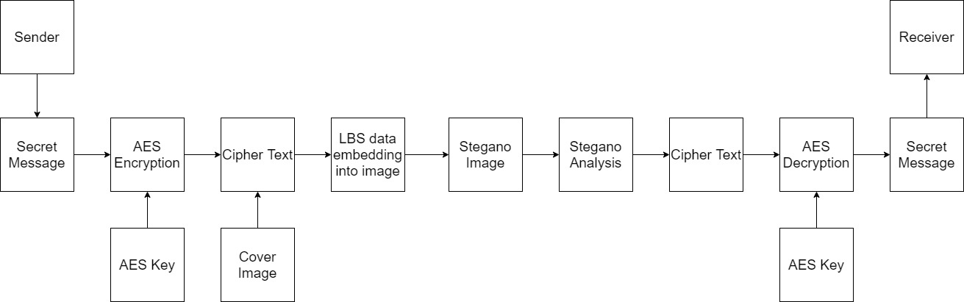
Architectural diagram

Slide 6
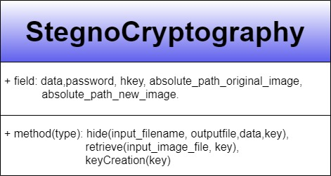
Structural Model
Class diagram

Slide 7
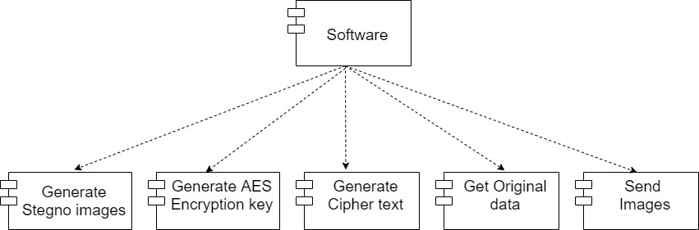
Component diagram

Slide 8
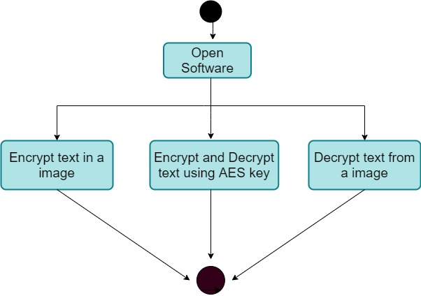
Behavioral Model
Activity diagram

Slide 9
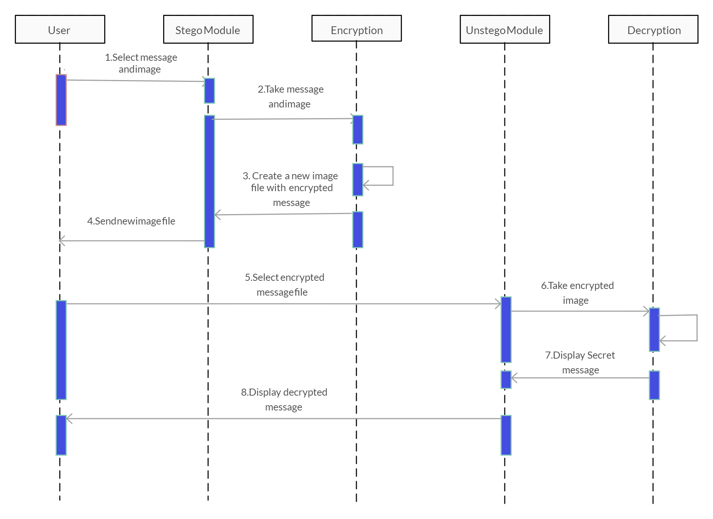
Sequence diagram

Slide 10
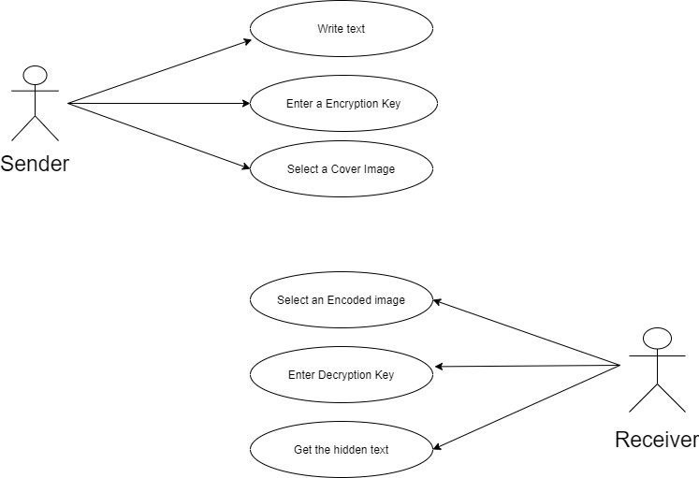
Use case diagram

Slide 11
Thanks!

